Slide 1
Intermediate Code Generator
Team Members:
Aditi – RA2011003010004
Shreeja – RA2011003010007
Devam – RA2011003010064

Slide 2
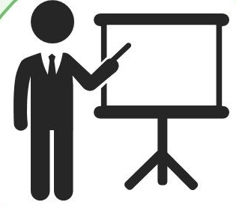
PRESENTATION OVERVIEW
INTRODUCTION
DIFFERENT MODULES OF PROJECT
DESIGN STRATEGY & IMPLEMENTATION DETAILS
SNAPSHOTS
CONCLUSION

Slide 3
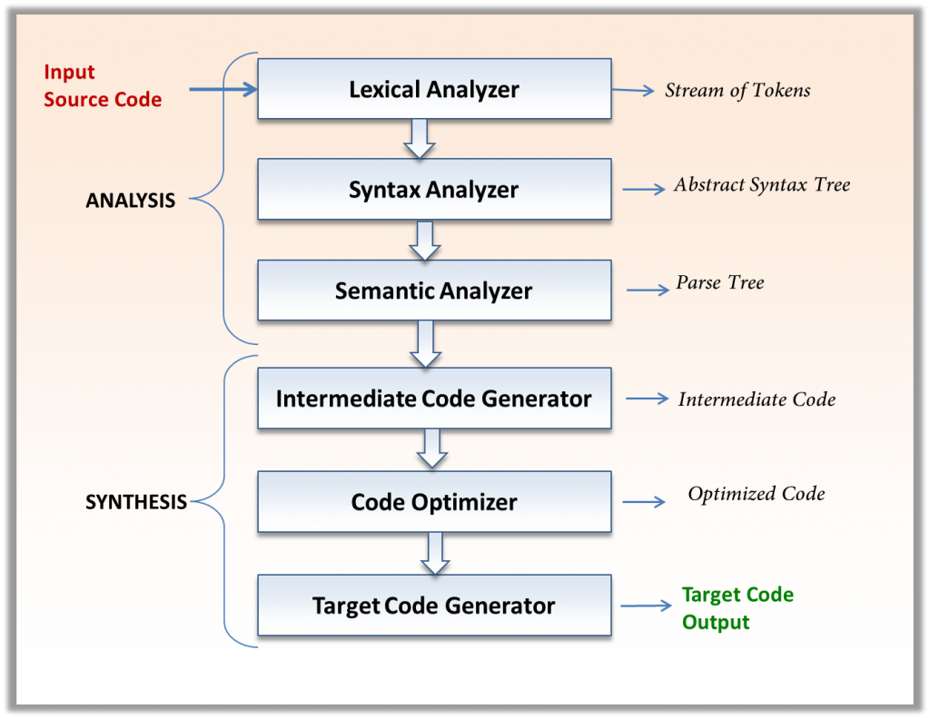
INTRODUCTION
The Mini-Compiler contains all phases of compiler. It has been made for the Python language by using C language (till intermediate code optimisation phase) and we used Python language itself for target code generation as well. The constructs that have been focused on are ‘if-else’ and ‘while’ statements. The final code displays the output of all the phases on the terminal, one after the other. First, the tokens are displayed, followed by a ‘Parse Successful’ message. Then abstract syntax tree is printed. Next, the symbol table along with the intermediate code is printed without optimisation. Finally, the symbol table and the intermediate code after optimisation is displayed. The final output is the target code. Specific error messages are displayed based on the type of error. Syntax and semantic errors have been handled. The line number is displayed as part of the error message. As a part of error recovery, panic mode recovery has been implemented for the lexer.

Slide 4
ABSTRACT
The Mini-Compiler, contains all phases of compiler has been made for the language Python by using C language (till intermediate code optimisation phase) and we used Python language itself for target code generation as well . The constructs that have been focused on are ‘if-else’ and ‘while’ statements. The optimizations handled for the intermediate code are ‘packing temporaries’ and ‘constant propagation’. Syntax and semantic errors have been handled and syntax error recovery has been implemented using Panic Mode Recovery in the lexer.

Slide 5
DIFFERENT MODULES OF PROJECT
Token_And Symbol_Table: This folder contains the code that outputs the tokens and the symbol table.
Abstract_Syntax_Tree: This folder contains the code that displays the abstract syntax tree.
Intermediate_Code_Generation: This folder contains the code that generates the symbol table before optimisations and the intermediate code.
Optimised_ICG: This folder contains the code that generates the symbol table after optimisations, the quadruples table and the optimised intermediate code.
Target_Code: This folder contains the code that displays the assembly code/target code.
Different Files:
proj.l : It is the Lexical analyser file which defines all the terminals of the productions stated in the yacc file. It contains regular expressions.
proj1.y: Yacc file is where the productions for the conditional statements like if-else and while and expressions are mentioned. This file also contains the semantic rules defined against every production necessary. Rules for producing three address code is also present.
final.py : It is the python file which converts the ICG to target code using regex.
inp.py : The input python code which will be parsed and checked for semantic correctness by executing the lex and yacc files along with it.

Slide 6
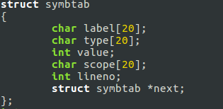


DESIGN STRATEGY AND IMPLEMENTATION DETAILS
SYMBOL TABLE CREATION
Linked list is being used to create the symbol table. The final output shows the label, value, scope, line number and type. We have created three functions to generate the symbol table. They are:
Insert: It pushes the node onto the linked list.
Display: It displays the symbol table.
Search: It searches for a particular label in the linked list.
ABSTRACT SYNTAX TREE
This is being implemented using a structure that has three members which hold the data, left pointer and right pointer respectively. The functions that aid in creating and displaying this tree are:
BuildTree: It is used to create a node of this structure and add it to the existing tree.
printTree: This function displays the abstract syntax tree using pre-order traversal.
INTERMEDIATE CODE GENERATION
We have used the stack data structure to generate the intermediate code that uses some functions, which are called based on some conditions. The following functions push onto the stack and generate the intermediate code, when called based on various conditions.
4. CODE OPTIMIZATION
A data structure known as quadruple is used to optimize the code. This data structure holds the details of each of the assignment, label and goto statements. The following functions are used to add to the quadruples table and display it onto the terminal.

Slide 7
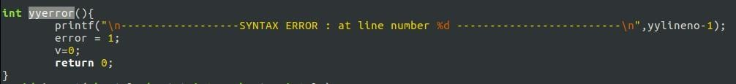
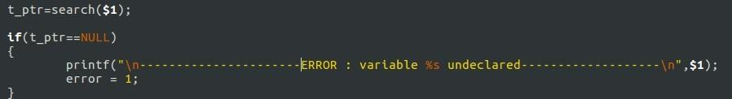

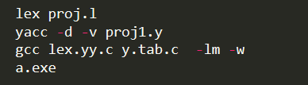
ERROR HANDLING
Syntax Error:
If the token returned does not satisfy the grammar, then yyerror() is used to display the syntax error along with the line number.
Semantic Error:
If there is an identifier in the RHS of an assignment statement, the symbol table is searched for that variable. If the variable does not exist in the symbol table, this is identified as a semantic error and is displayed.
Error Recovery:
Panic Mode Recovery is used as the error recovery technique, where if the variable declaration has been done with a number at the start, it ignores the number and considers the rest as the variable name. This has been implemented using regex.
6. TARGET CODE GENERATION
The optimised intermediate code is read from a text file, line after line, and goes through a series of if-else loops to generate the target code.
BUILD AND RUN THE PROGRAM
The commands on the left side need to be executed on the terminal to build and run the program which is inside the project folder that contains the code for the compiler.

Slide 8
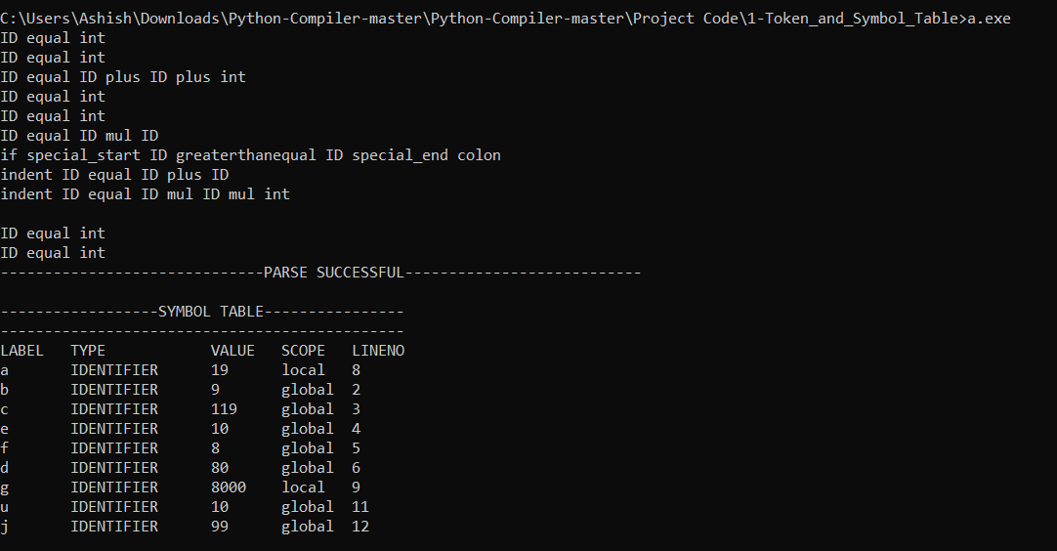
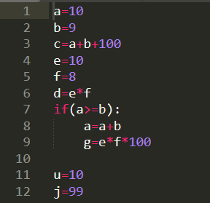
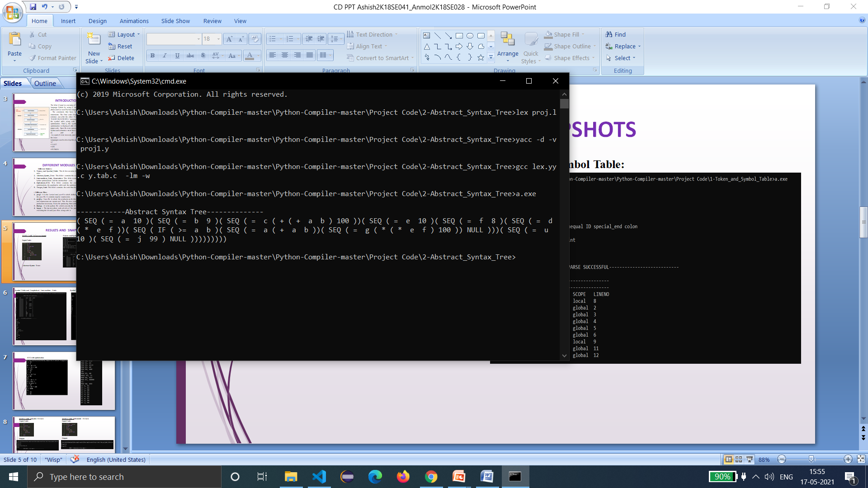
RESULTS AND SNAPSHOTS
TEST CASE 1 (Correct input):
Input Code:
Tokens and Symbol Table:
Abstract Syntax Tree:

Slide 9
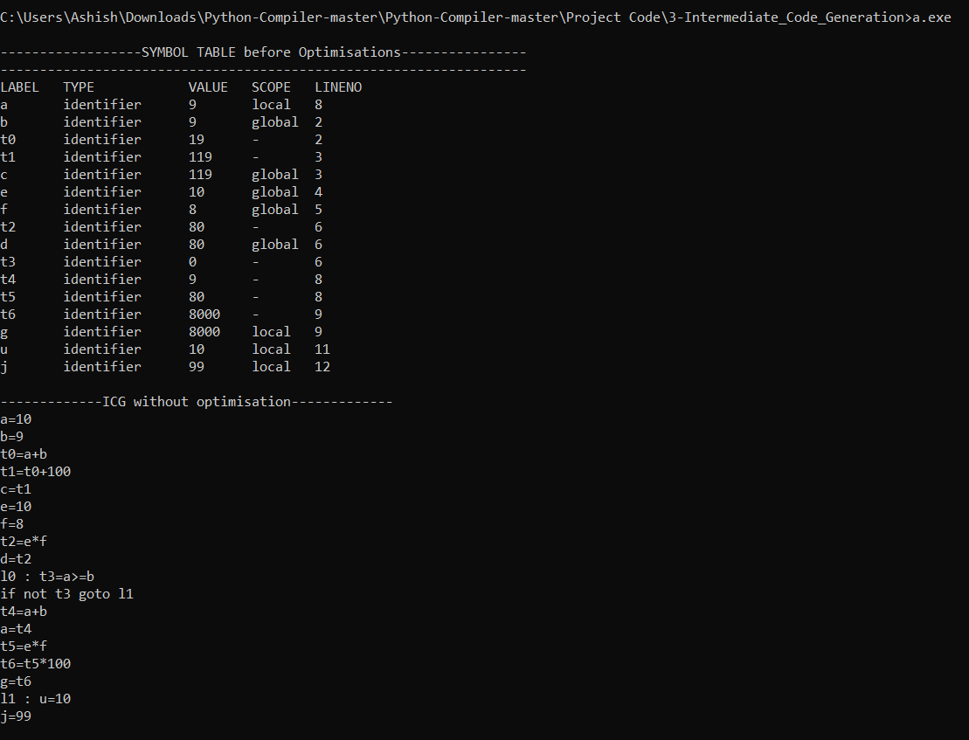
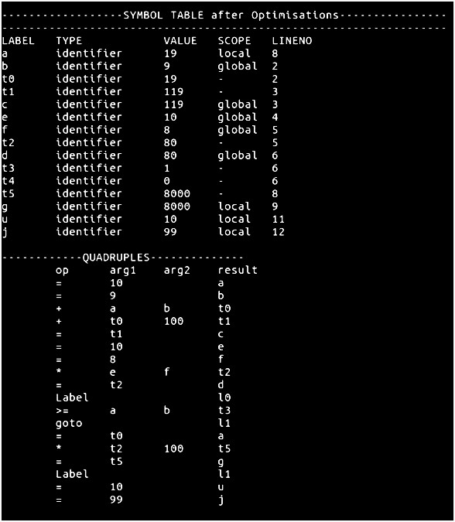
Symbol Table and Unoptimised Intermediate Code:
Symbol Table, Quadruples Table after optimisation:

Slide 10
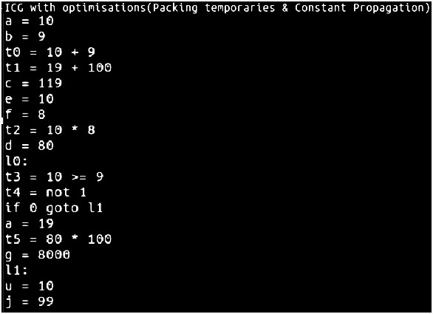
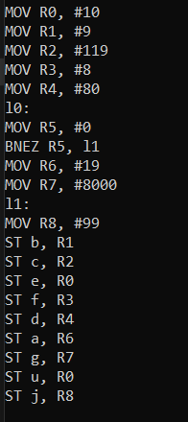
ICG with optimisation:
TARGET CODE:

Slide 11
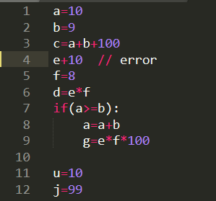
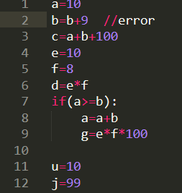
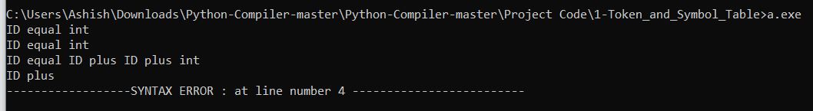
TEST CASE 2 (Syntax Error):
Input Code:
TEST CASE 3 (Semantic Error):
Input Code:
Output:
Output:

Slide 12
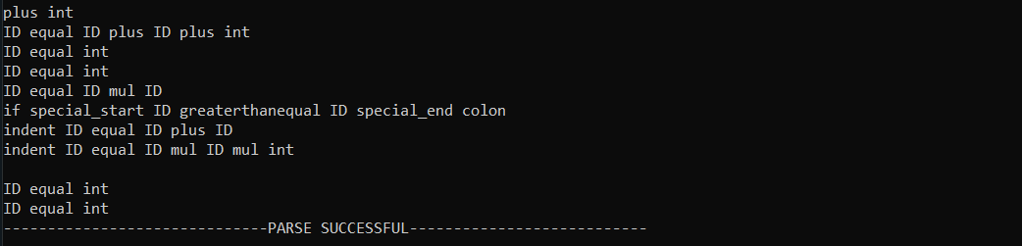
TEST CASE 4 (Error Recovery):
Input Code:
Output:

Slide 13
Results and Shortcomings
The mini-compiler built in this project works perfectly for the ‘if-else’ and ‘while’ constructs of Python language. Our compiler can be executed in different phases by building and running the code separated in the various folders. The final code displays the output of all the phases on the terminal, one after the other. First, the tokens are displayed, followed by a ‘PARSE SUCCESSFUL’ message. The abstract syntax tree is printed. Next, the symbol table along with the intermediate code is printed without optimisation. Finally, the symbol table and the intermediate code after optimisation is displayed after the quadruples table. The final output is the target code, written in the instruction set architecture followed by the hypothetical machine model introduced in this project. This is for inputs with no errors. But in case of erroneous inputs, the token generation is stopped on error encounter and the corresponding error message is displayed.
This mini-compiler has the following shortcomings: • User defined functions are not handled. • Importing libraries and calling library functions is not taken care of. • Datatypes other than integer and float, example strings, lists, tuples, dictionaries, etc have not been considered. • Constructs other than ‘while’ and ‘if-else’ have not been added in the compiler program.

Slide 14
CONCLUSION
Making a full complete compiler is a very difficult task and it takes lots of time to make it. So, we have successfully made a mini compiler which performs following operations:
This is a mini-compiler for python language using lex and yacc files which takes input a python program and according to the context free grammar written, the program is validated.
Regular Expressions are written to generate the tokens.
Symbol table is created to store the information about the identifiers.
Abstract syntax tree is generated and displayed according to the pre-order tree traversal.
Intermediate code is generated, and the data structure used for optimisation is Quadruples.
The optimised intermediate code is then converted to the Target code using a hypothetical machine model.
Error handling and recovery is also implemented that take cares of erroneous inputs.

Slide 15
THANK YOU

